Slide 1
Server and Projects Portfolio Management
TEAM MEMBERS
M SATYA SAI LAKSHMI
A SWAPNA
K L D SINDHUJASRI
K HEMA VARSHINI
Y POOJITHA
M LIKHITHA
(frontend developer)
(frontend developer)
(backend developer)
(backend developer)
(cloud engineer)
(cloud engineer)

Slide 2
Our Expected Growth Path
It displays the graphs and pie chart of the server and project data
Dashboard
server
Complete details of servers used in Technical Hub
Showing the project list and developers data in Technical Hub
Project

Slide 3
ABOUT PROJECT
a. Project introduction
In the fast-paced landscape of modern IT operations, effective management of servers and projects is paramount to organizational success. The Server and Project Portfolio Management project aims to address this need by providing a unified platform for overseeing and optimizing both server infrastructure and project portfolios.
Utilizing cutting-edge technologies such as React Native for the front end and MongoDB for backend data storage, this project offers a robust and scalable solution. The React Native framework ensures a seamless user experience with its cross-platform capabilities and intuitive interface design. Meanwhile, MongoDB, a powerful NoSQL database, provides flexibility and performance in storing and retrieving critical server configurations and project details.
Through this integrated platform, users gain comprehensive visibility into their server assets and ongoing projects. Features include real-time monitoring of server statuses, streamlined project management functionalities, and centralized documentation of project timelines and milestones. By consolidating these aspects into a single application, the project aims to enhance operational efficiency, facilitate informed decision-making, and promote collaboration across teams.
Server and Project Portfolio Management represents a commitment to leveraging technology for optimizing IT infrastructure and project workflows. It empowers organizations to streamline operations, reduce overhead costs associated with server management, and improve overall project delivery timelines. Join us on this journey as we redefine how enterprises manage their technological resources and project initiatives in the digital age.

Slide 4
b. Project requirments:
Hardware:
Processor: Intel – I3.
RAM:2 GB.
Hard Disk: 256 GB.
Software:
OS: Windows / MAC / Linux.
JAVA:JDK Version (16,17,20).
Database: MySQL Workbench.
IDE: IntelliJ IDEA
c. Project modules:
Server- It shows the details of server.
1. Dashboard: It displays the pie charts.
2.ListOfServers: It displays the list of servers in cards.
*ADDSERVER: To add the new Server.
*Actions:
1.Edit: It changes the existing data.
2.Delete: clearing the existing data.

Slide 5
Projects – It shows the details of project.
1.ListOfProjects: It displays the list of projects in table format.
*ADD Project: To add the new Project.
*Actions:
1.Edit: It changes the existing data.
2.Delete: clearing the existing data.
2.Developers: It displays the developer details in table format.
Domains-
1.ListOfDomains: It displays the list of domains in table format.
*ADD Project: To add the new Domain.
*Actions:
1.Edit: It changes the existing data.
2.Delete: clearing the existing data.

Slide 6
Technologies :
Frontend: Certainly! Think of the frontend as the face of a website or app.Its what you see and interact with on your screen-the button you click, the text you read, and the images you view. The front end is usually accessed by a client, and the back end forms the core of the application where all the business logic is applied. (React js)
Backend: Back-end development means working on server-side software, which focuses on everything you can't see on a website. Back-end developers ensure the website performs correctly, focusing on databases, back-end logic, application programming interface (APIs), architecture, and servers.(Nodejs, MongoDB)
Cloud: Cloud computing refers to the delivery of computing services such as servers, storage, databases, networking, software, and more over the Internet . Users can access these services on-demand and pay as you go .(Microsoft Azure)

Slide 7
Advantages :
Server management includes implementing security measures such as regular updates, and access controls.
It involves monitoring server performance, identifying bottlenecks.
It allows for scalability, enabling resources to be added or removed dynamically based on changing demands.
PPM ensures that projects are selected, prioritized, and executed in alignment with the strategic objectives of the organization.
Reduces the manual work and by that we can identify that which are under maintenance and which are working properly.
Server project portfolio management helps in centralizing project information for easy access and organization.
It enables real-time updates and collaboration among team members, enhancing project efficiency.
The system provides detailed insights and analytics for informed decision-making and resource allocation.
It offers a comprehensive view of all projects, allowing for prioritization and alignment with strategic goals.
Server project portfolio management streamlines communication and enhances transparency across the project lifecycle.

Slide 8



Where It Can Be Useful:
Corporate Project Management Offices (PMOs):
To manage multiple projects efficiently, track progress, allocate resources, and ensure alignment with organizational goals.
Construction Companies:
For managing construction projects, tracking milestones, and ensuring compliance with safety and regulatory standards.
IT Departments:
For managing IT projects, tracking infrastructure changes, and maintaining project documentation.

Slide 9
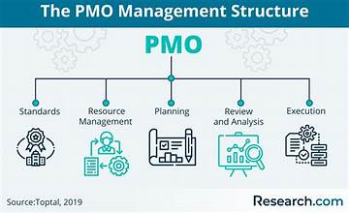
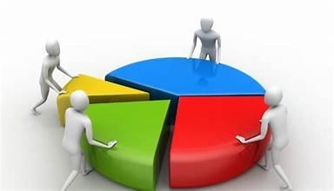
How It Can Be Useful:
Centralized project management:
Unified view: Provides a centralized platform for viewing all projects, their status, and interdependencies.
Consistency:Standardizes project management processes across the organization
Resource Allocation:
Efficient Allocation: Helps in optimizing the use of resources across various projects.
Conflict Resolution: Identifies and resolves resource conflicts, ensuring that critical projects are not stalled.

Slide 10
How we plan to improve this project
1. Enhance User Interface and Experience (UI/UX):
Intuitive Design: Simplify the interface to make it more user-friendly and intuitive.
Mobile Accessibility: Ensure the system is accessible on mobile devices for on-the-go project management.
Customizable Dashboards: Allow users to customize their dashboards according to their roles and preferences.
2. Integrate Advanced Analytics and Reporting:
Data Analytics: Incorporate advanced data analytics to provide deeper insights into project performance.
Predictive Analytics: Use predictive analytics to forecast project outcomes and potential risks.
Custom Reports: Enable the creation of custom reports tailored to specific stakeholder needs.

Slide 11
3. Enhance Resource Management:
Resource Optimization: Use AI and machine learning to optimize resource allocation and utilization.
Resource Forecasting: Implement tools for forecasting resource needs based on project schedules and workloads.
Skills Management: Develop a skills inventory to match resources with project requirements effectively.
4. Enhance Security and Compliance:
Data Security: Implement advanced security measures to protect sensitive project data.
Compliance Management: Ensure the system complies with industry standards and regulatory requirements.
Audit Trails: Maintain detailed audit trails for all project activities to enhance accountability and transparency.

Slide 12
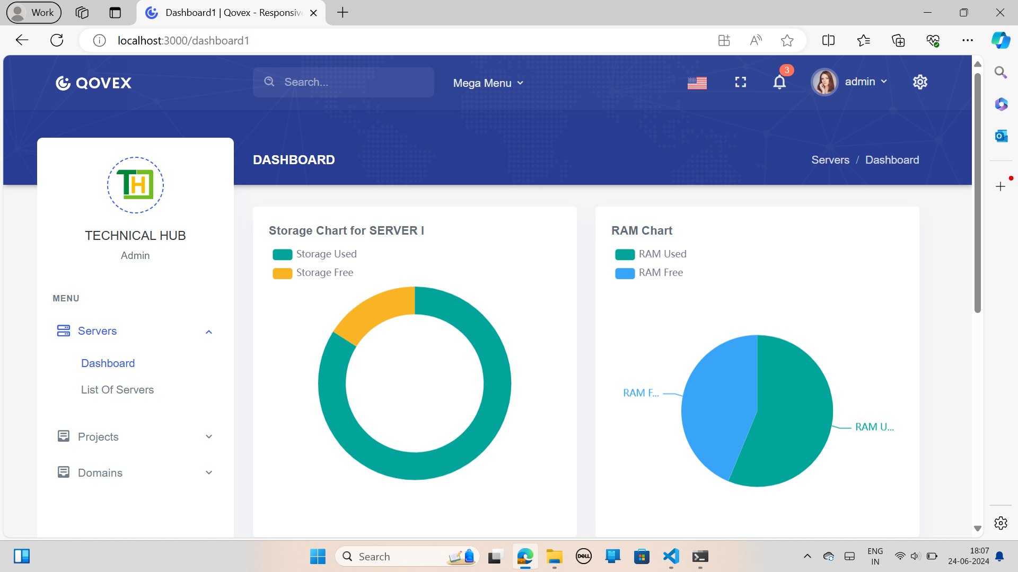
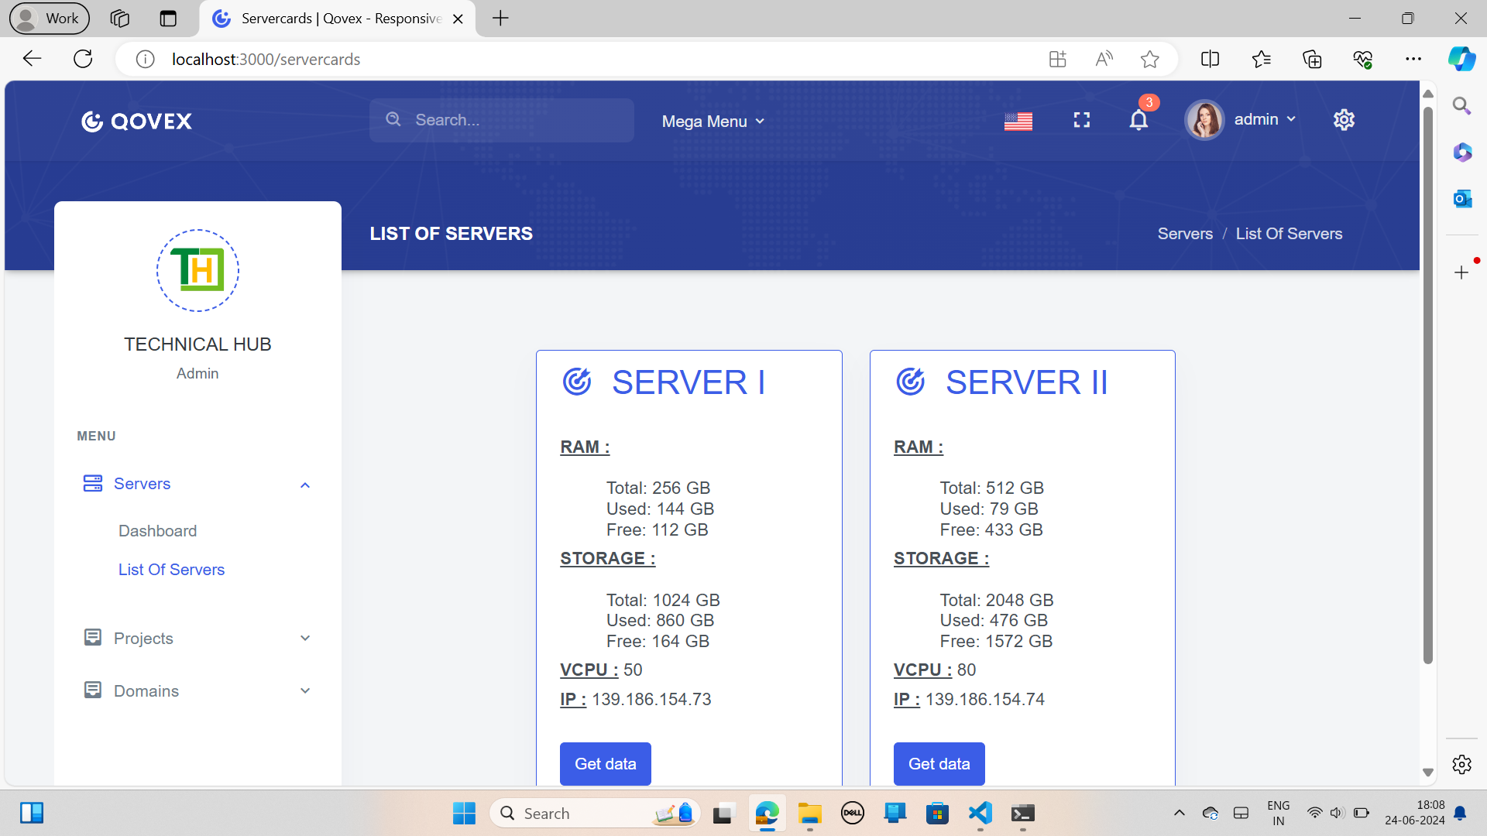
Outputs:
List of server page
This Page designed for servers information. It shows server information such as RAM, STORAGE, VCPU and IP, validates the data, and stores it in a database. The entire information of servers was displayed in cards as shown in above image.
Dashboard page
This Page designed for server dashboard. It collects server information such as Storage, RAM, and more, validates the data, and stores it in a database. If the data is valid and successfully stored, it displays the pie diagrams as shown in above image

Slide 13
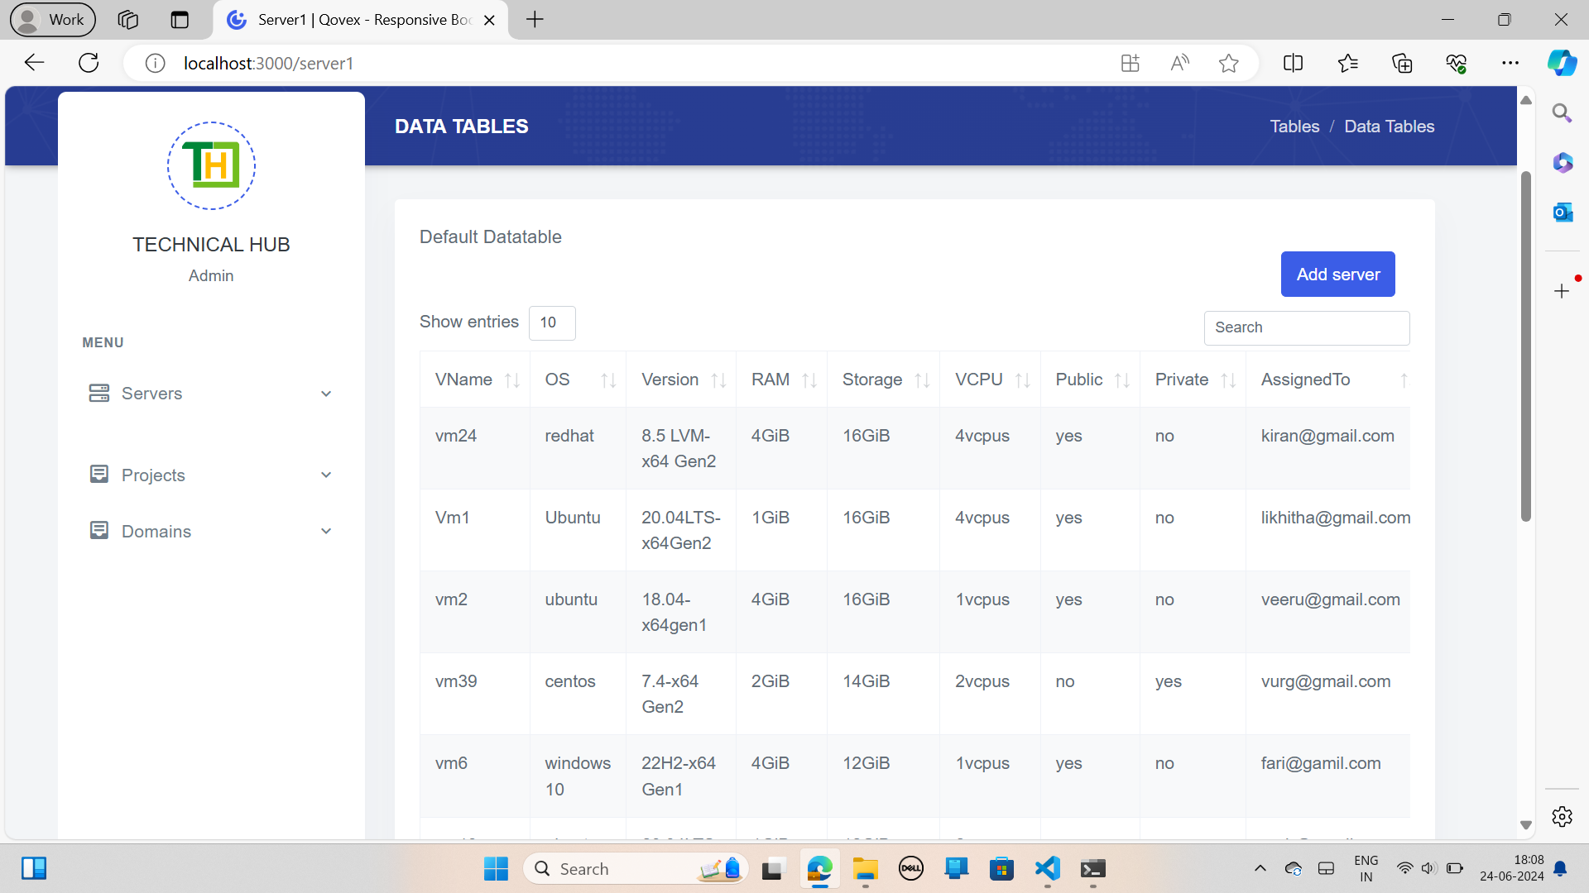
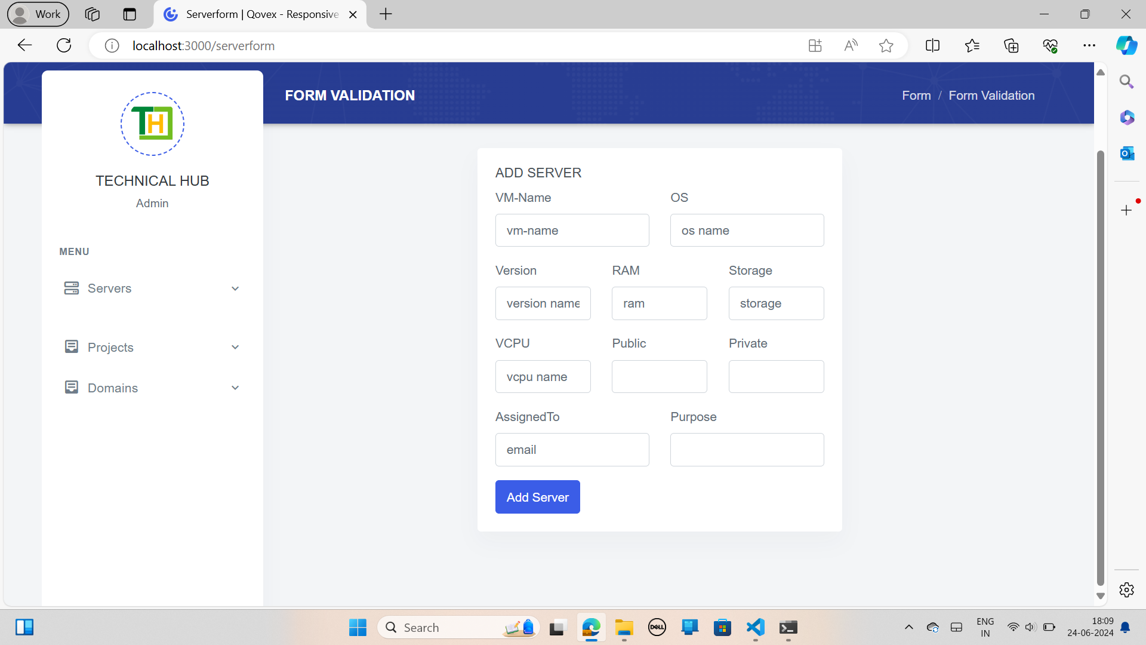
Server page
This Page designed to display Servers information. It shows servers information such as RAM, STORAGE, VCPU, IP, Public and private. It shows the information in table format as shown in above image
Add server page
This Page designed to add the new server to the database. It displays the form with fields such as RAM, STORAGE, VCPU, IP, Public and private. By clicking the add server the information entered in fields will saved to the database.

Slide 14
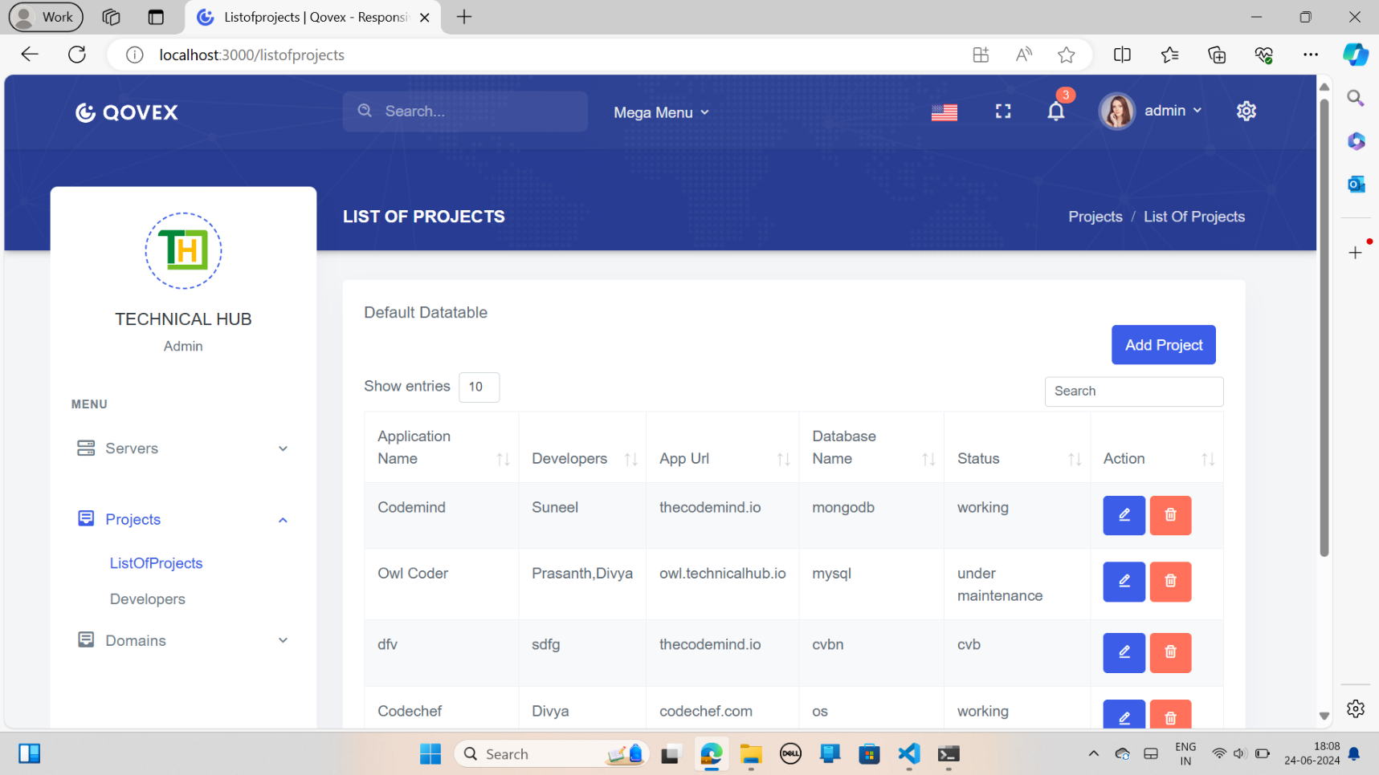
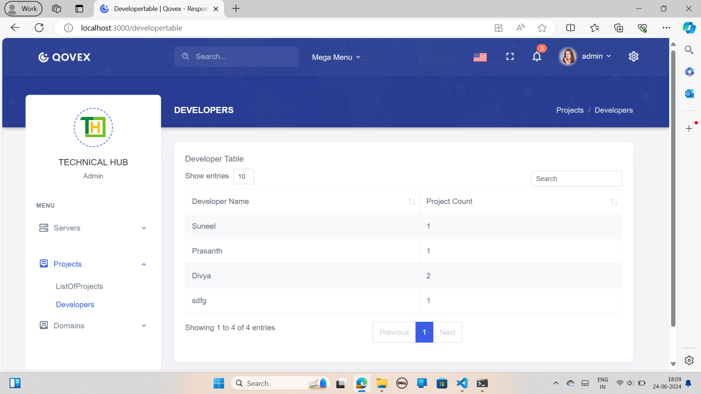
List of projects page
This Page designed to display the project information. It shows projects information such as Application Name, Developer, App URL, Database Name, status and Action. It shows the information in table format as shown in above image. In Action it contains two options edit and delete.
Developers page
This Page designed to display the developer’s information. It shows developers information such as Developer Name, and project count.

Slide 15
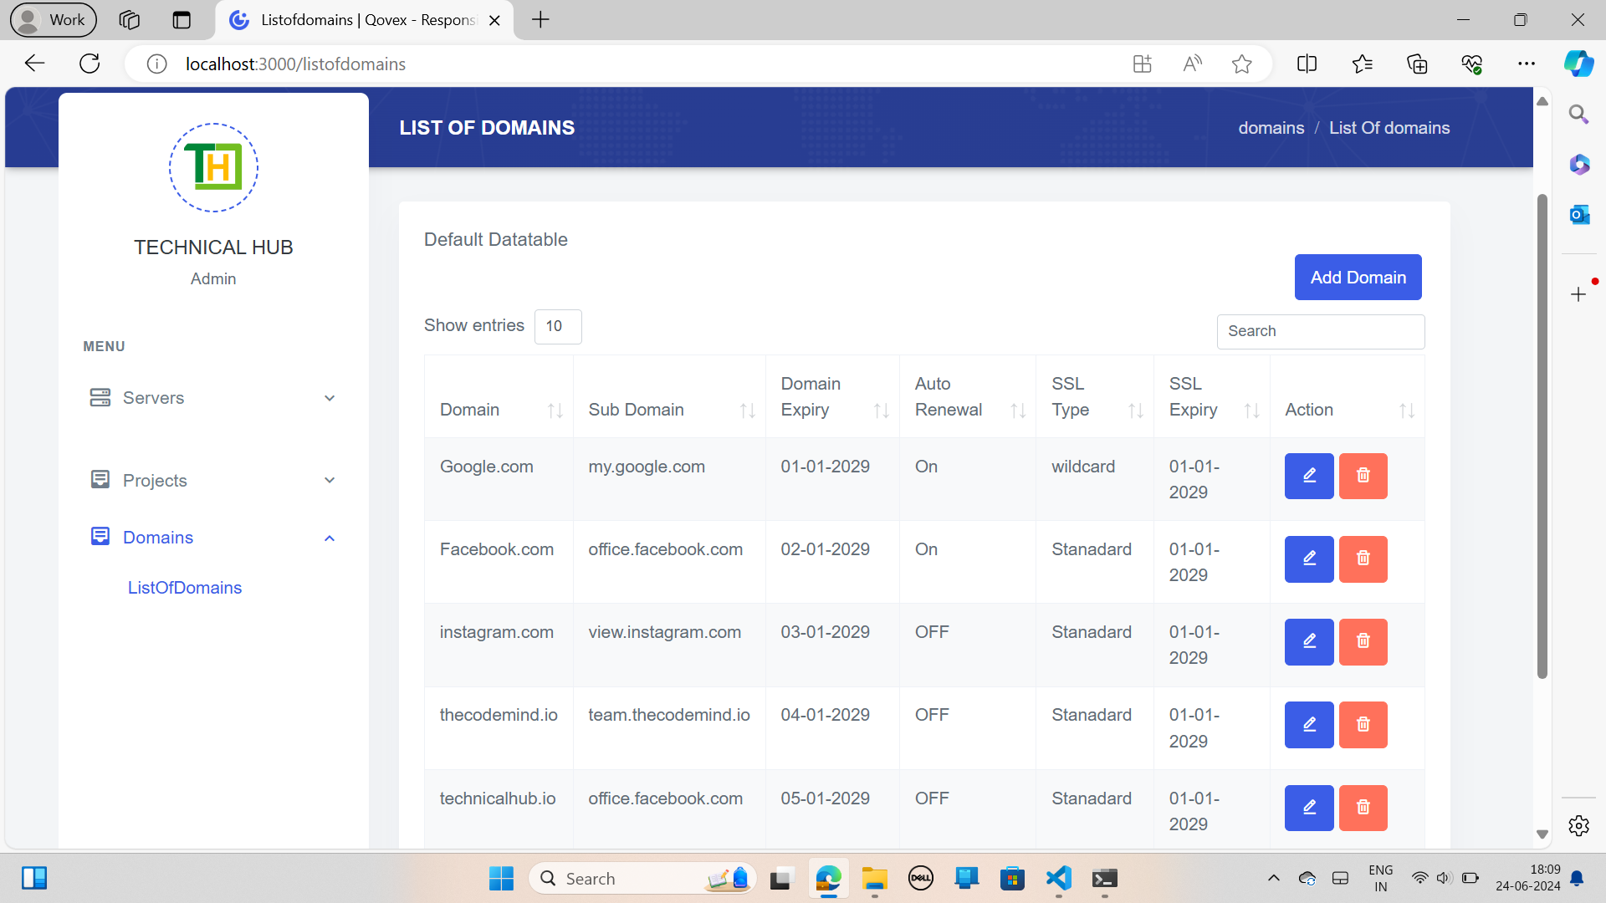
List of domains page:
This Page designed to display the domain information. It shows the information in table format as shown in above image. In Action it contains two options edit and delete.

Slide 16


